Slide 1
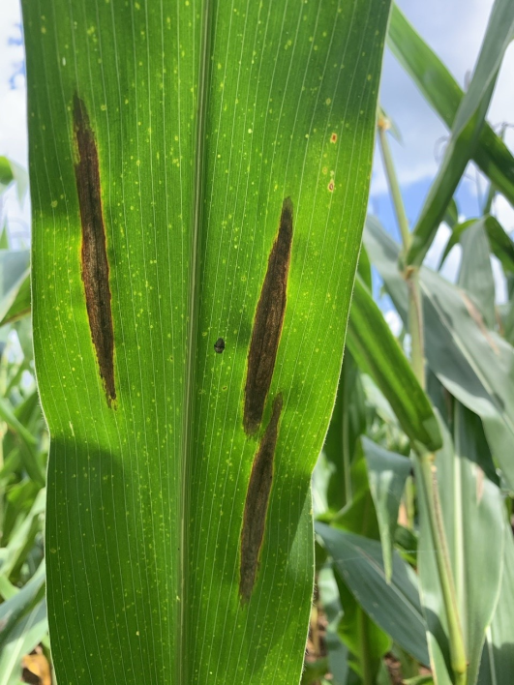
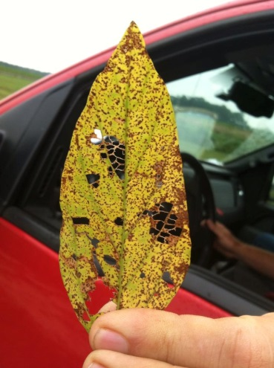
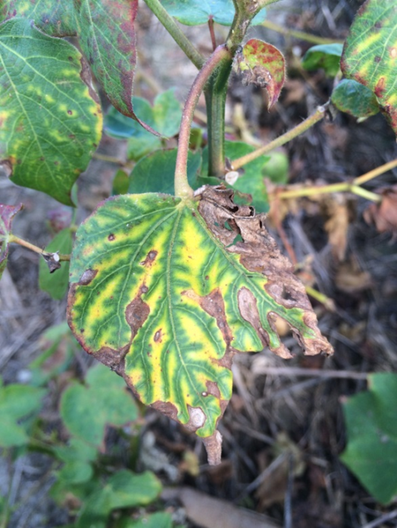
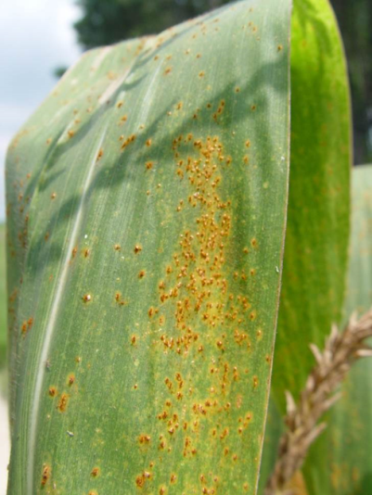



Why correct ID is essential for control recommendations
Robert C. Kemerait Jr., PhD
Professor and Extension Specialist
Department of Plant Pathology
University of Georgia CAES
Follow on Twitter “bob kemerait”

Slide 2
Why correct ID is essential for control recommendations
Incorrect ID costs a grower time.
Incorrect ID costs a grower money.
Incorrect ID costs a grower yield and profit.
Incorrect ID affects trust a grower has for Extension.

Slide 3
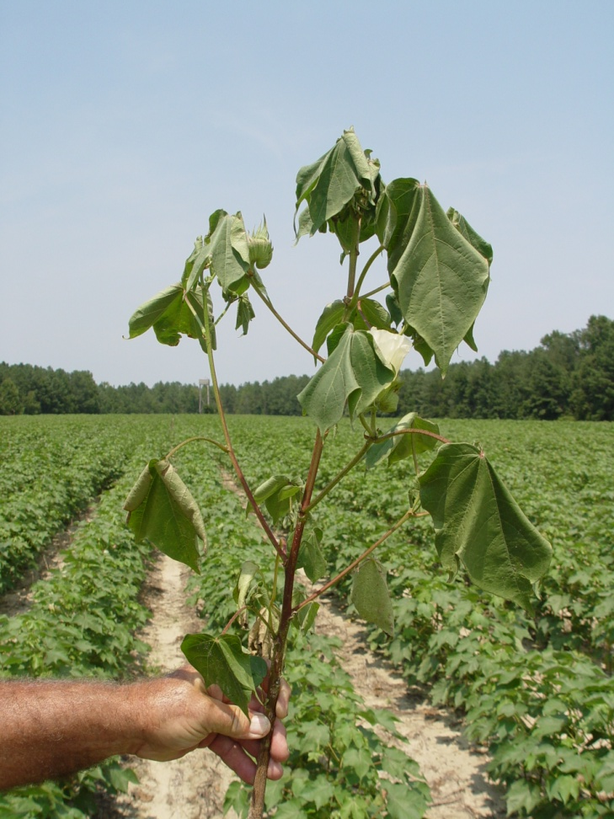
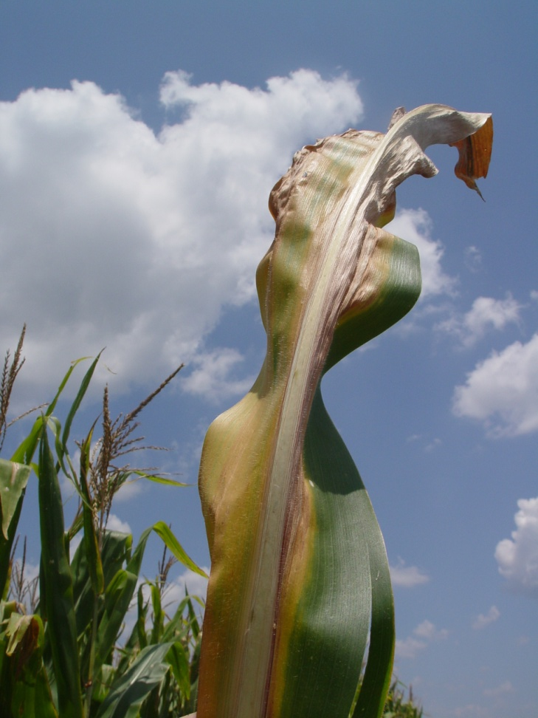
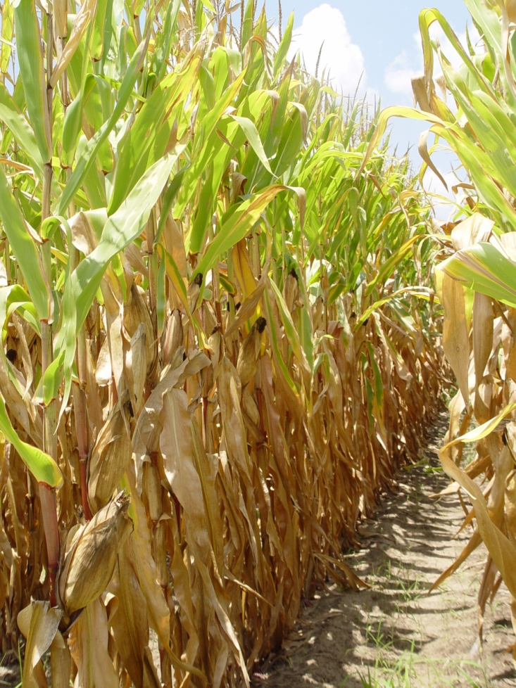
Unknown Problem, why?

Slide 4
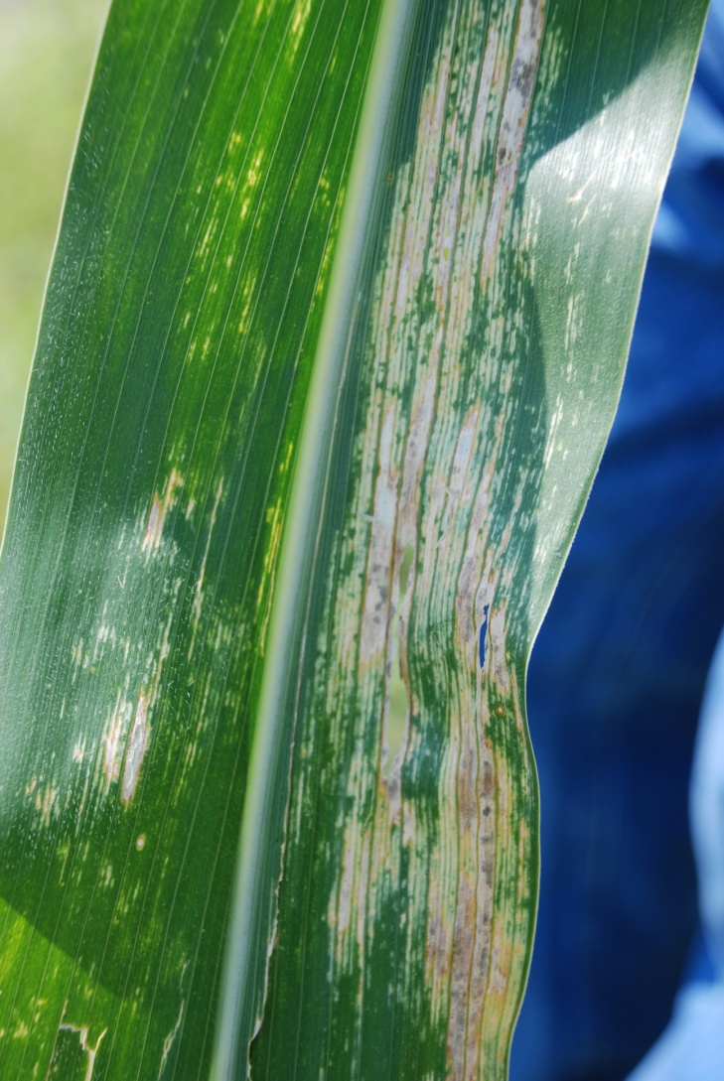
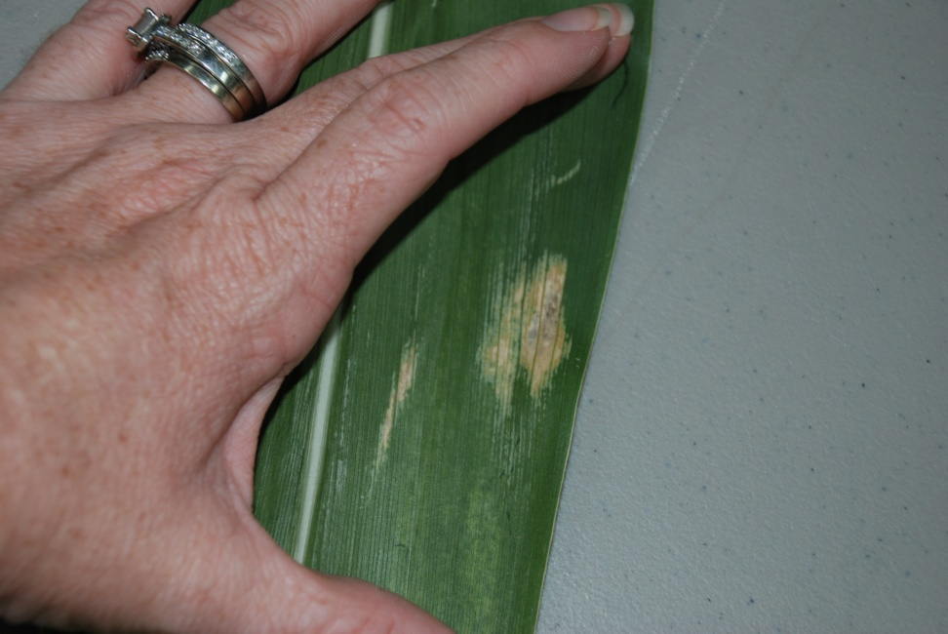
Unknown problem. Why?

Slide 5
NOT A DISEASE…….
Chemical burns and injury……
  Tan/buckskin centers to spots
  No sporulation of TRUE pathogens
  Spots may show chemical residue or odd shapes.
Environmental injuries……..
Sun-scalding…….
LOOK FOR PATTERNS IN THE FIELD!!
  Row patterns
  Drift patterns/gradients
  Damage occurred at specific time/growth stage.

Slide 6
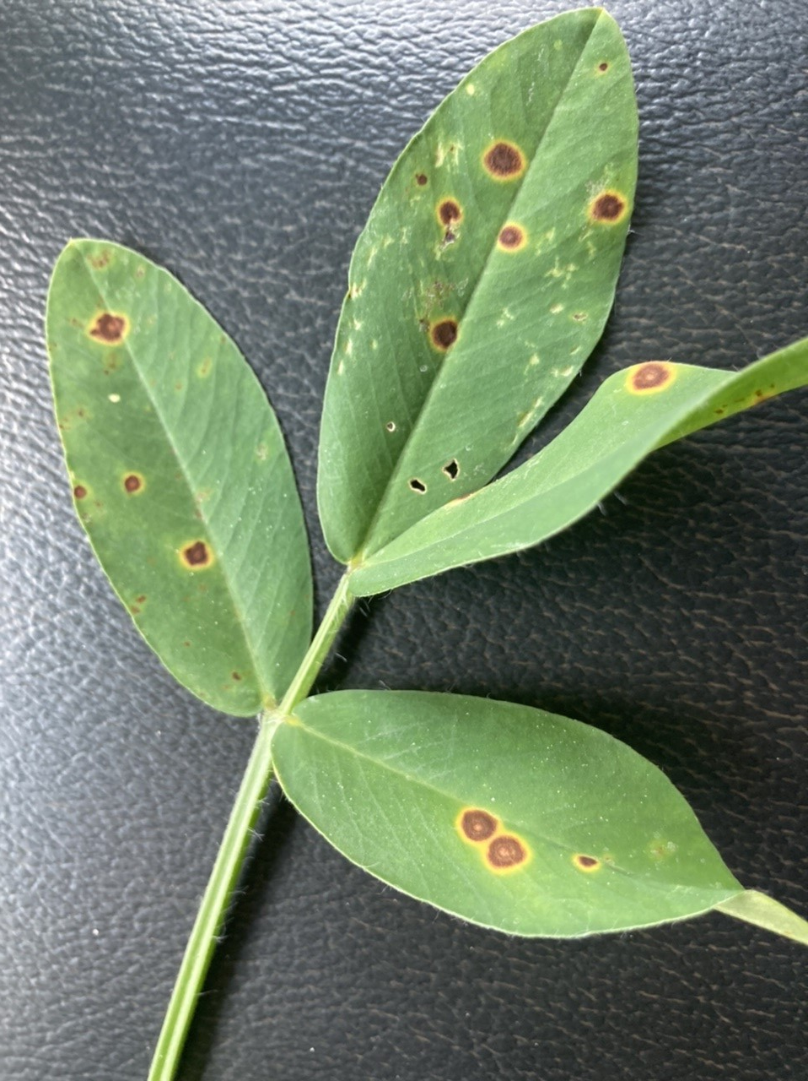
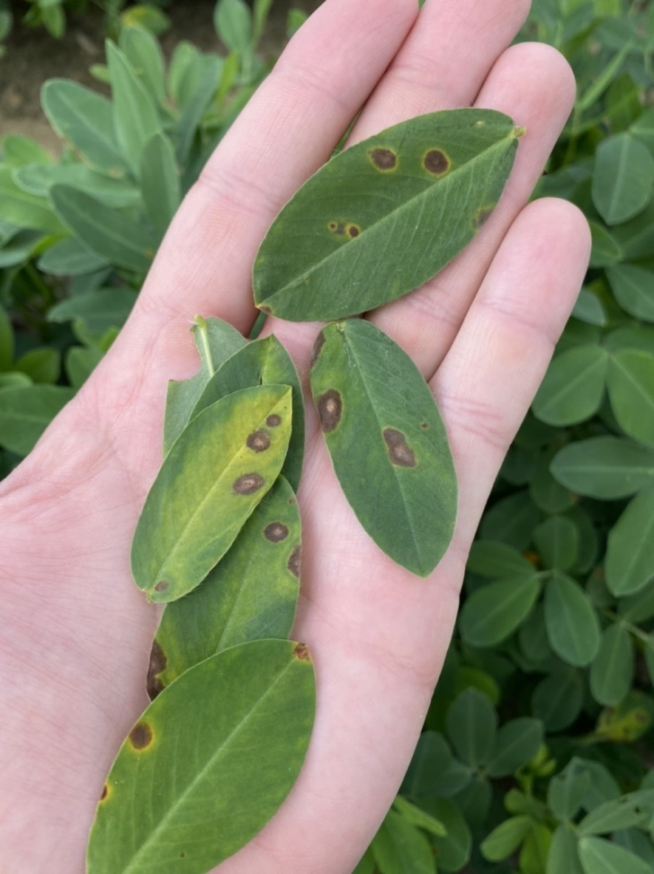
Chemical Injury

Slide 7
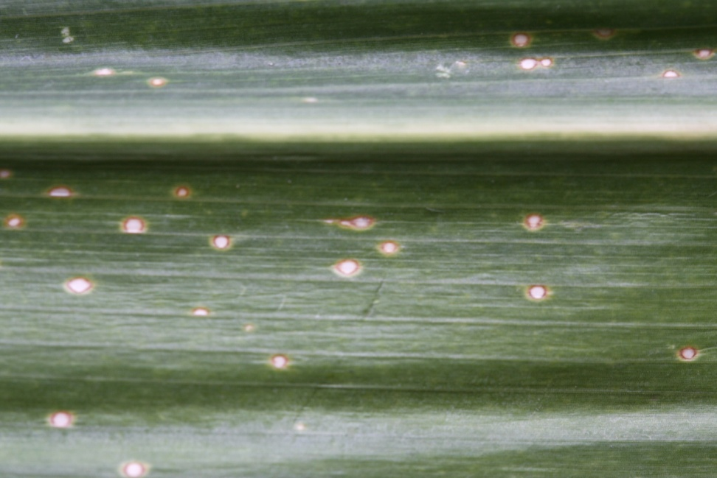
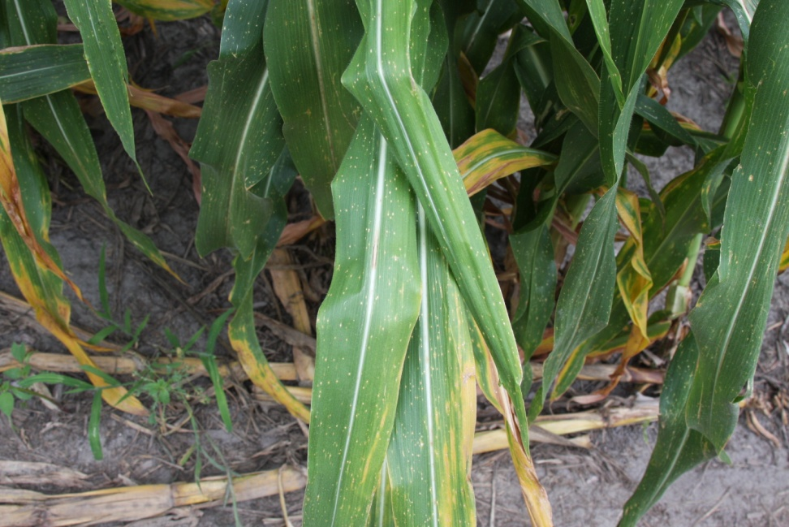
Gramoxone/Paraquat injury likely NOT “HOLCUS leaf spot”

Slide 8
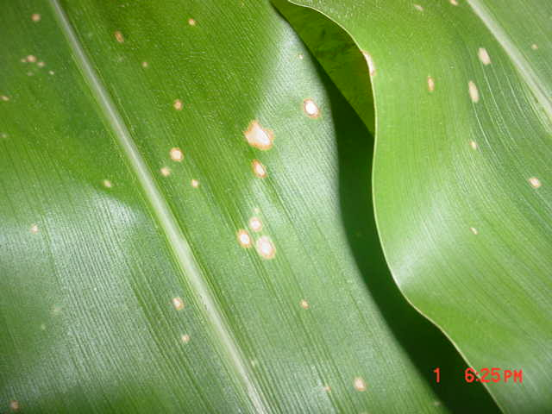
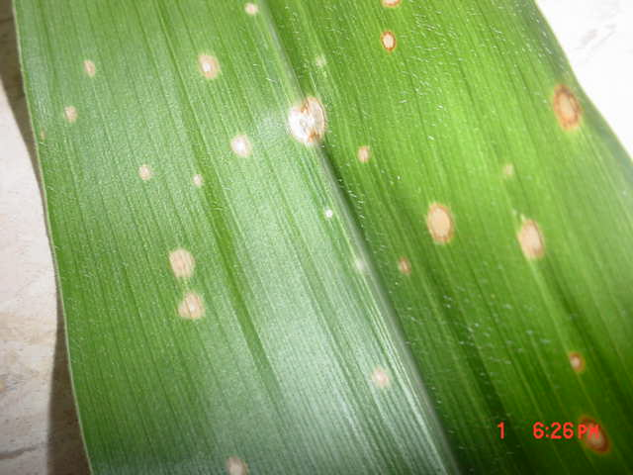

Slide 9
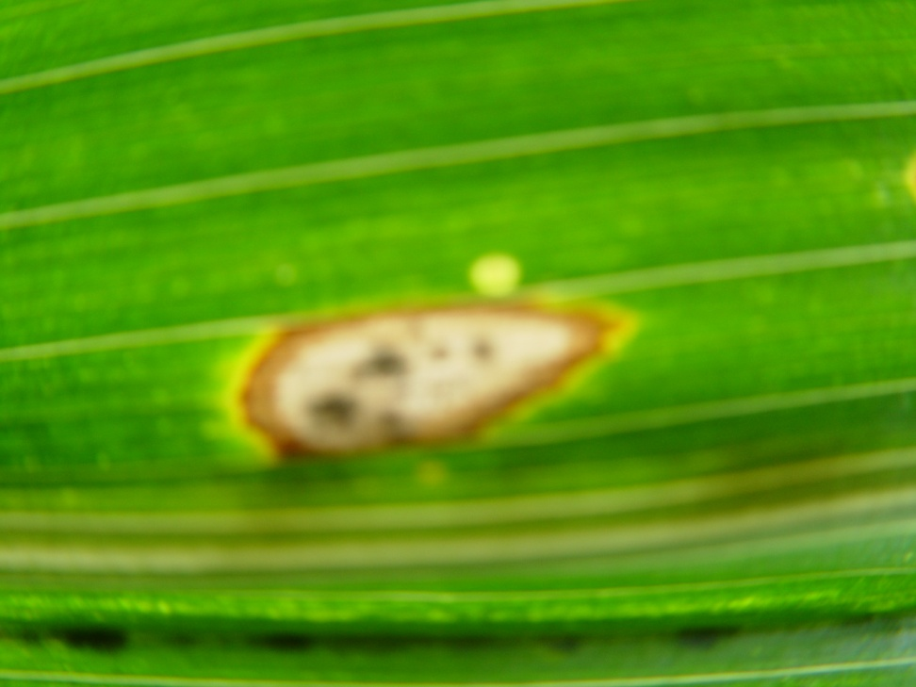
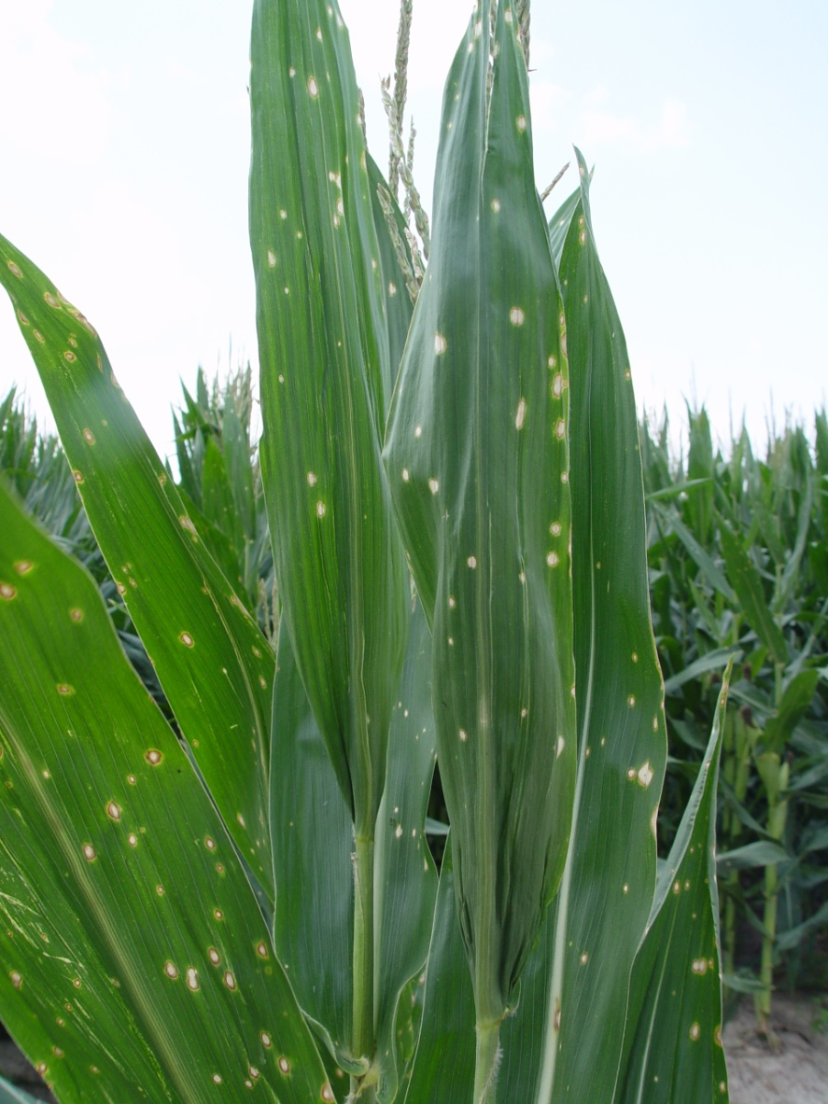

Slide 10
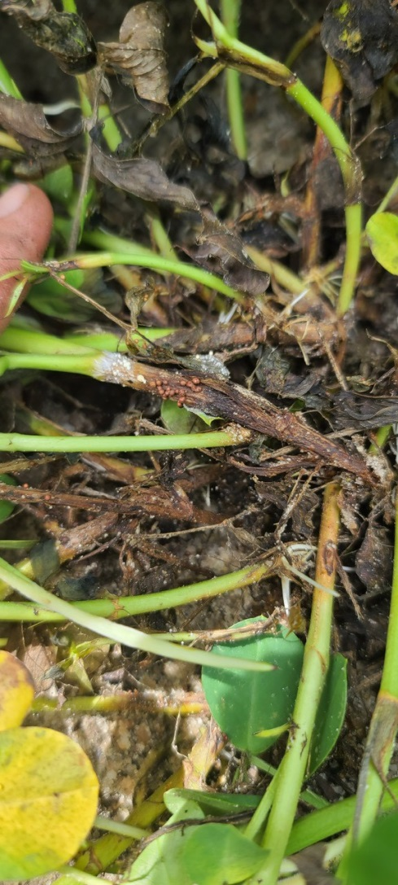
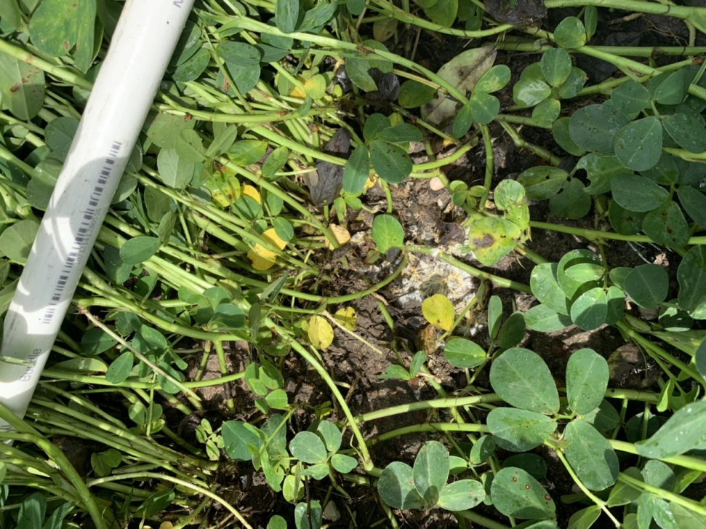
“False white mold” vs White Mold

Slide 11
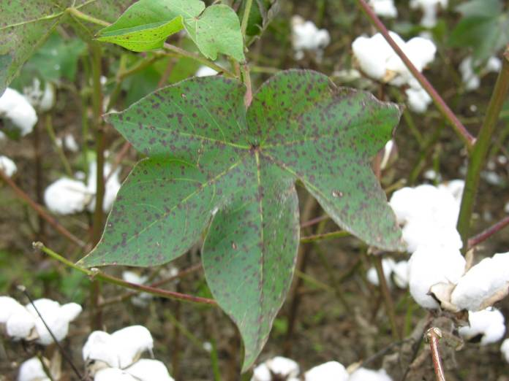
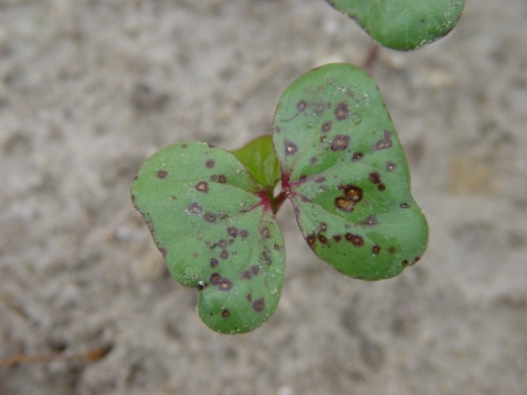
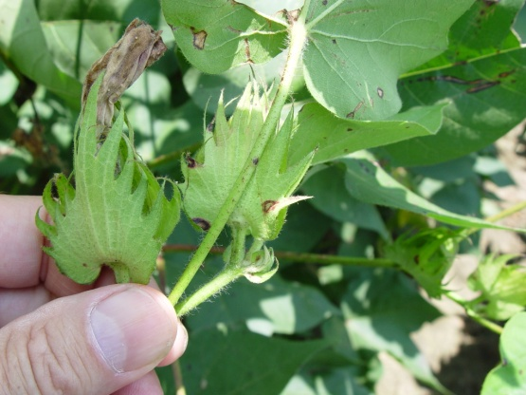
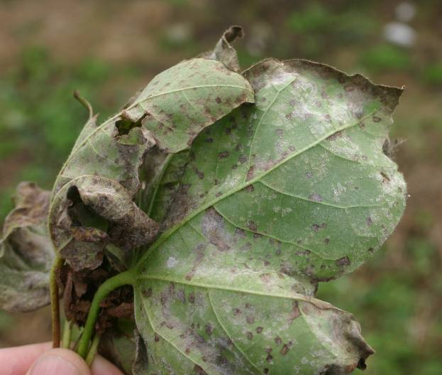
Foliar Diseases of Cotton
Typically considered “incidental” for cotton production in Georgia.
Various causes-
  E.g. Cercospora, Stemphylium, Alternaria
  Stemphylium leaf spot tied to nutrient deficiencies?
Wet weather blight (Ascochyta blight)
  Phoma
  Typically seen on younger plants
  Can occur later in season on foliage, bolls, bracts
Aereolate mildew
  Ramularia
  Sporadic occurrence
Boll Rots
  Typical boll rot
  “Hardlock”
Ascochyta wet weather blight
Aereolate mildew, Appling Trial 2007

Slide 12
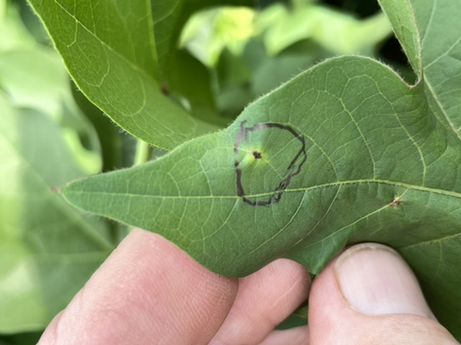
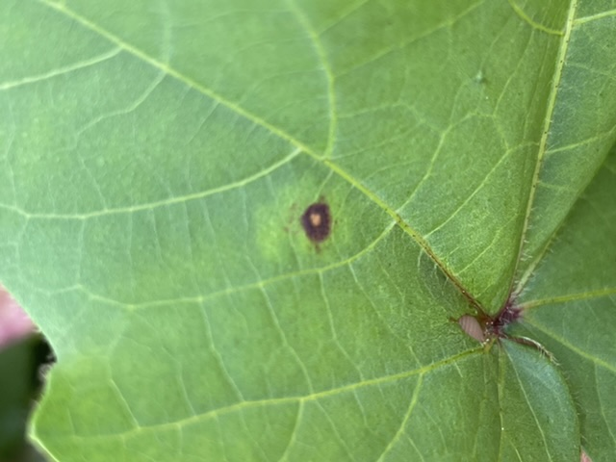
What is it? Does it matter?

Slide 13
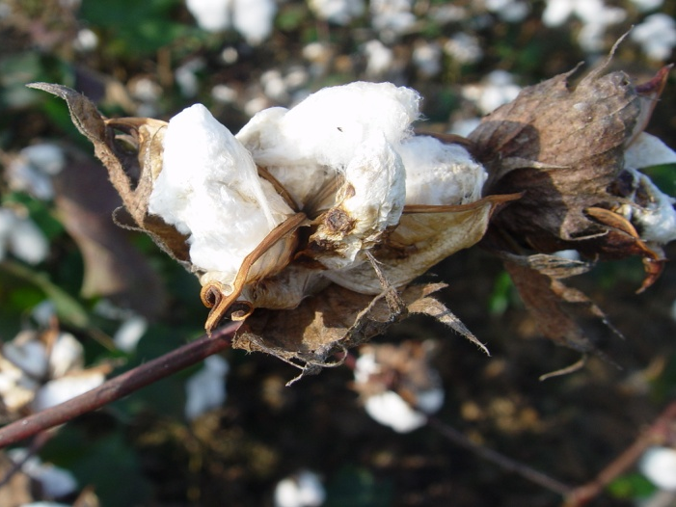
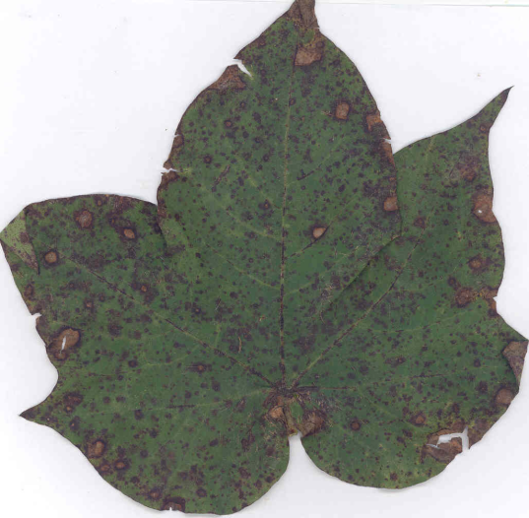
Despair in Identifying Cotton Diseases..
“Bob, it is sometimes difficult to make heads-or-tails from University data because you all don’t report the pathogen..” Industry Cooperator
Identification of rots and hardlock
  Opportunistic fungi
  Stink bug, hardlock, Fusarium hardlock
Leaf spots
  Often sporulating poorly
  May have a mix of pathogens/opportunists
  One spot may look like any other spot

Slide 14
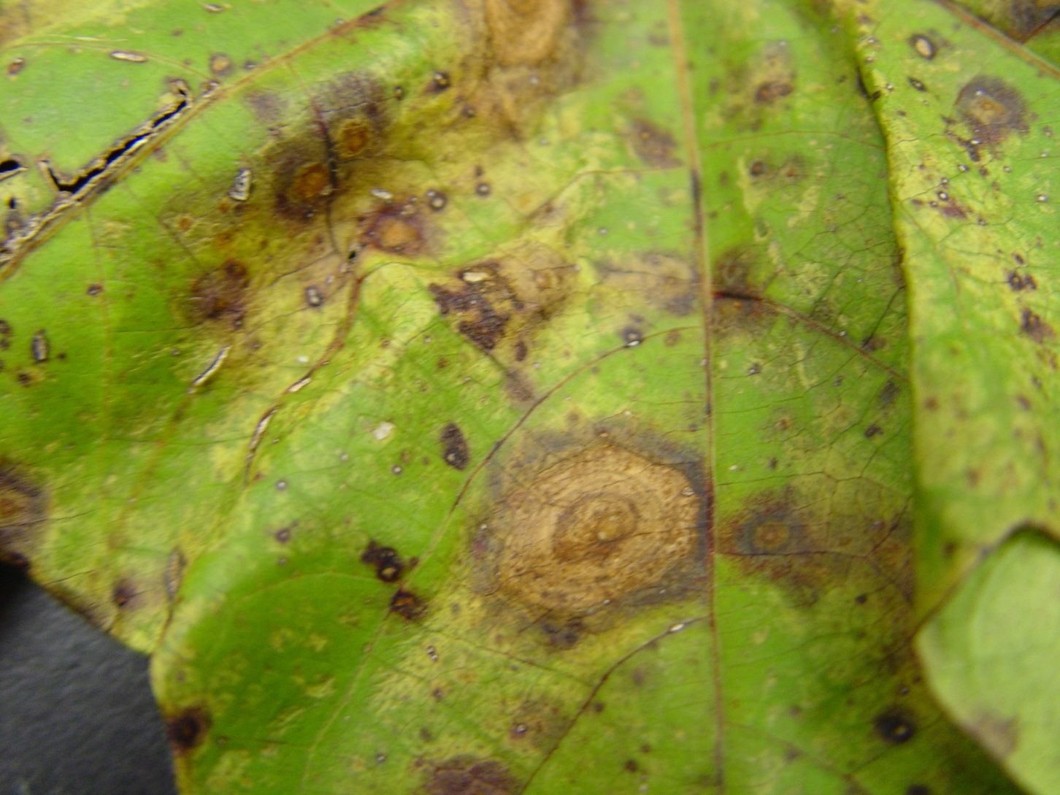
Target Spot on Cotton
Colquitt County 2009

Slide 15
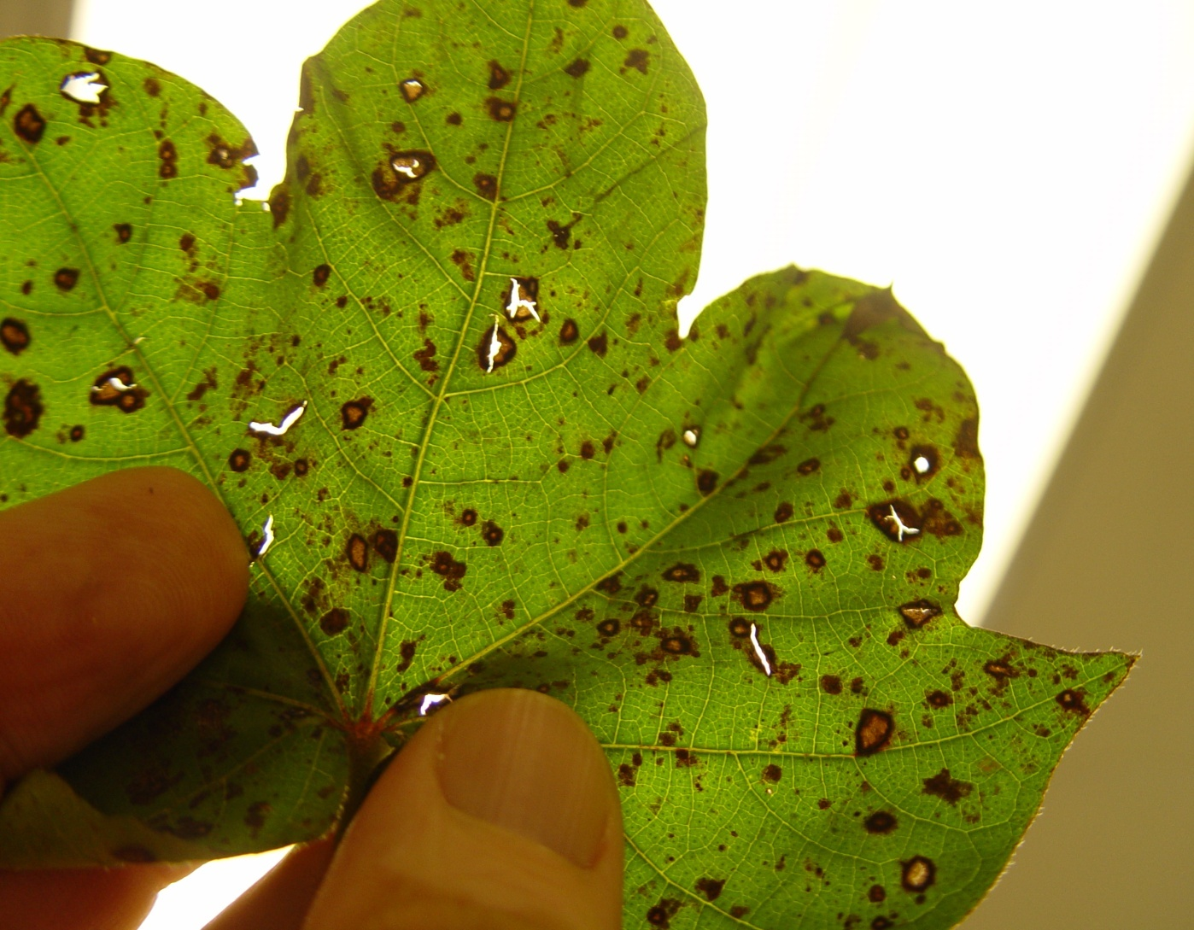
Stemphylium Leaf Spot on Cotton
(from Attapulgus)

Slide 16
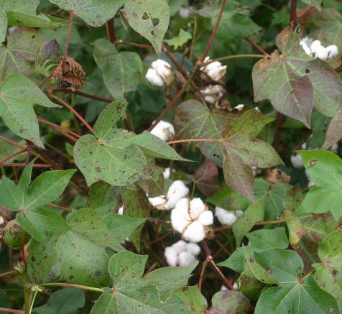
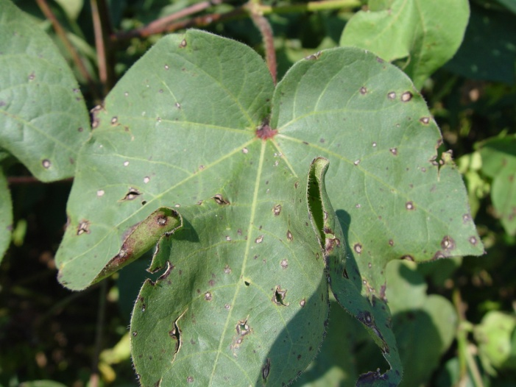
Stemphylium leaf spot

Slide 17
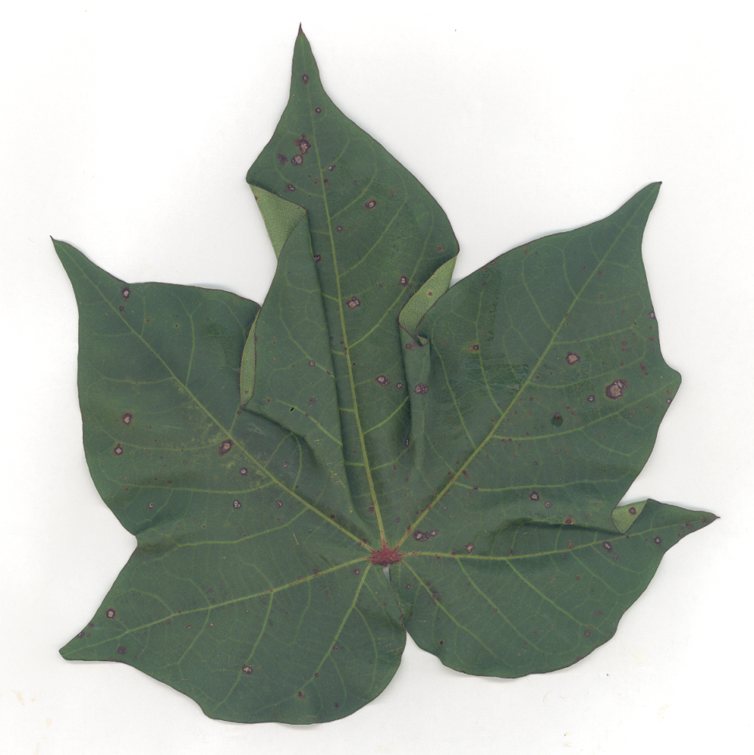
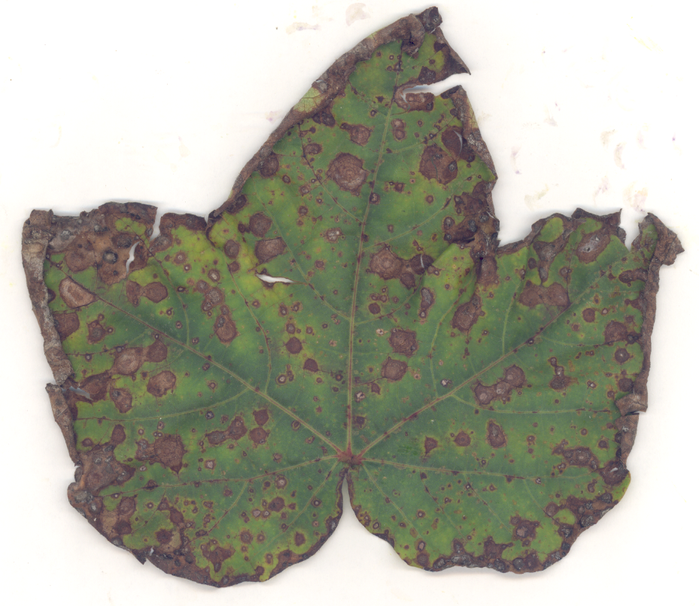
Two applications of Headline (6 fl oz/A) and
0 lb/A vs 180 lb/A potassium
Stemphylium leaf spot 2010

Slide 18
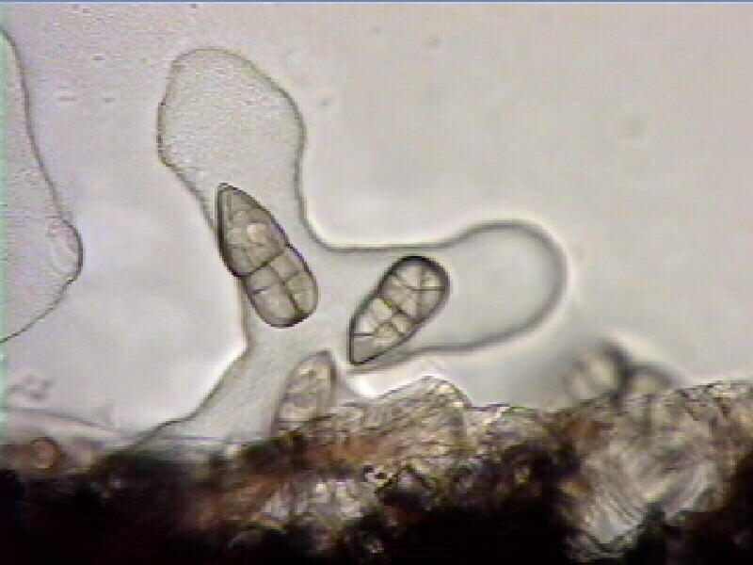
Stemphylium Leaf Spot on Cotton
Seminole County 2009
Rome Ethredge

Slide 19
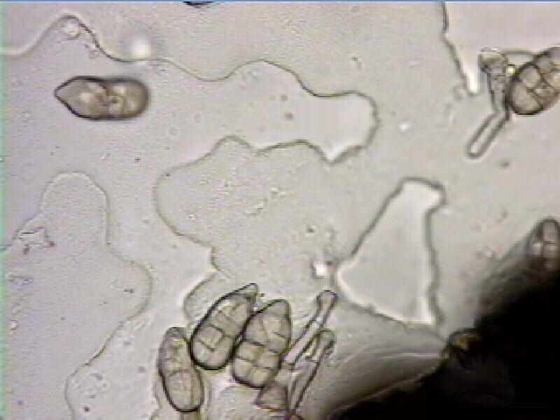
Stemphylium Leaf Spot on Cotton
Seminole County 2009
Rome Ethredge

Slide 20
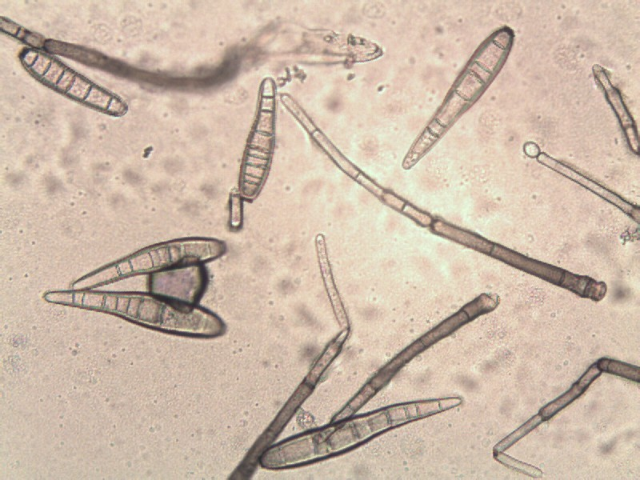
Corynespora cassiicola
Colquitt County 2009

Slide 21
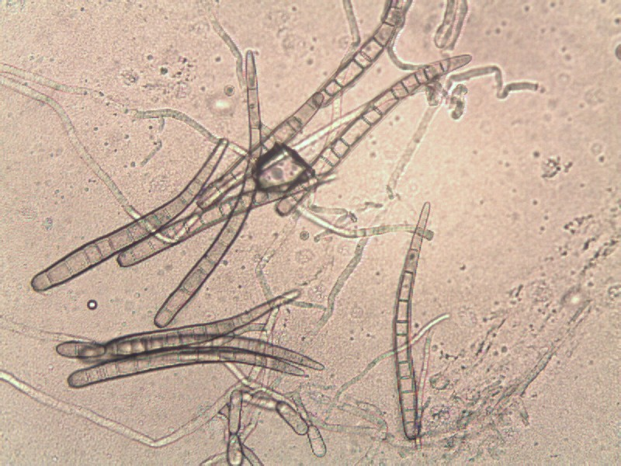
Corynespora cassiicola
Colquitt County 2009

Slide 22
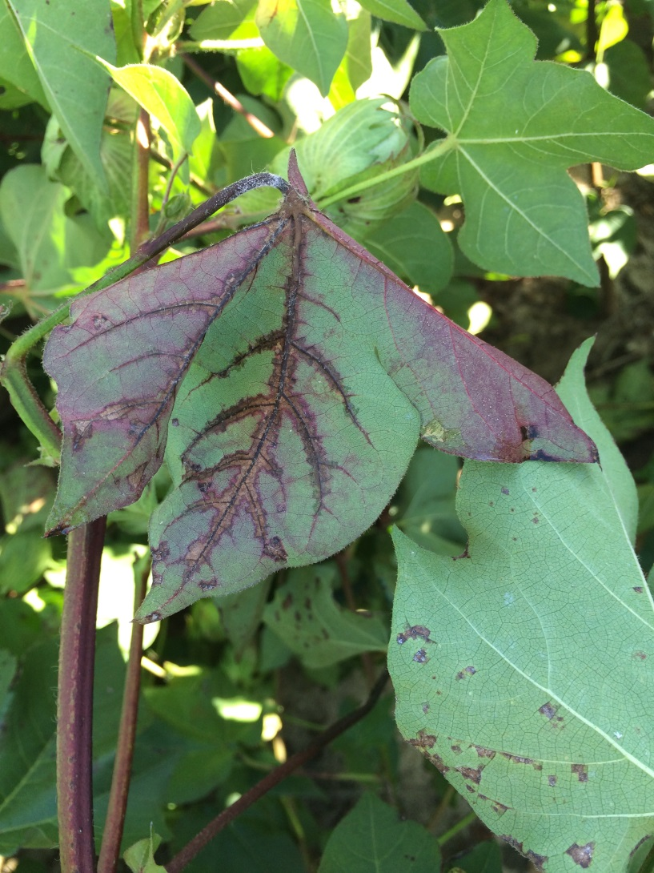
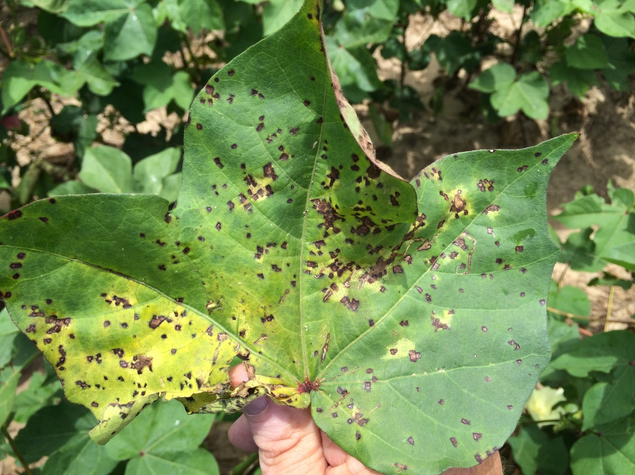
Foliar Symptoms of Bacterial Blight

Slide 23
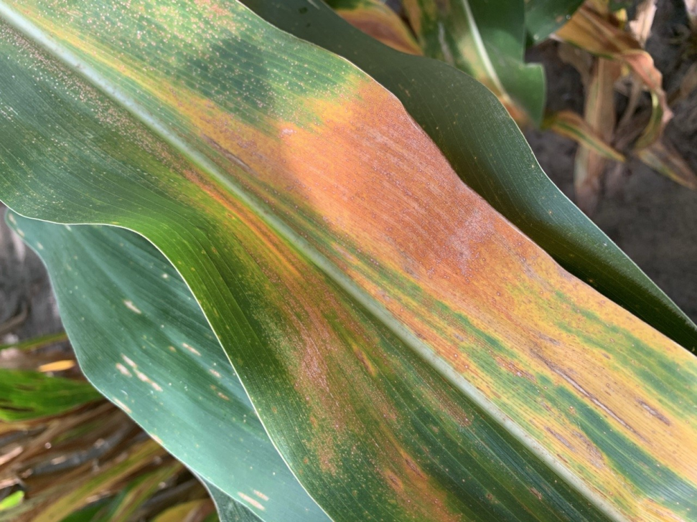
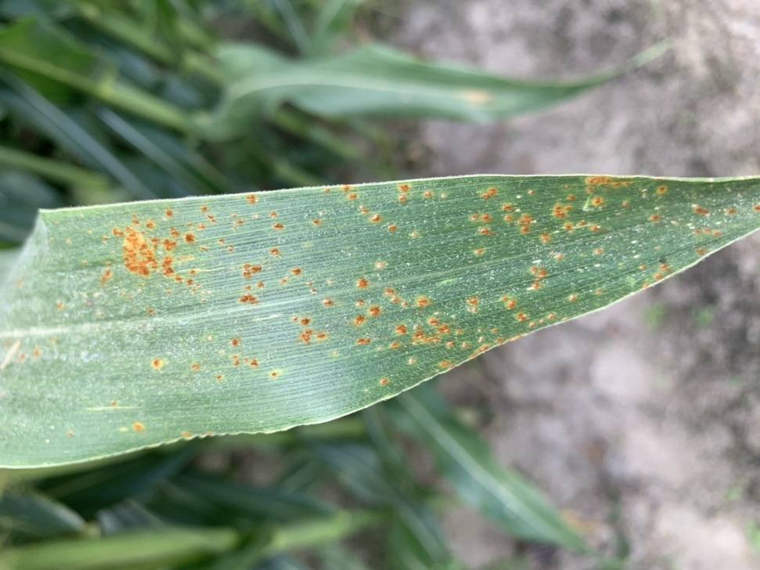
What looks “rusty” to a corn grower

Slide 24
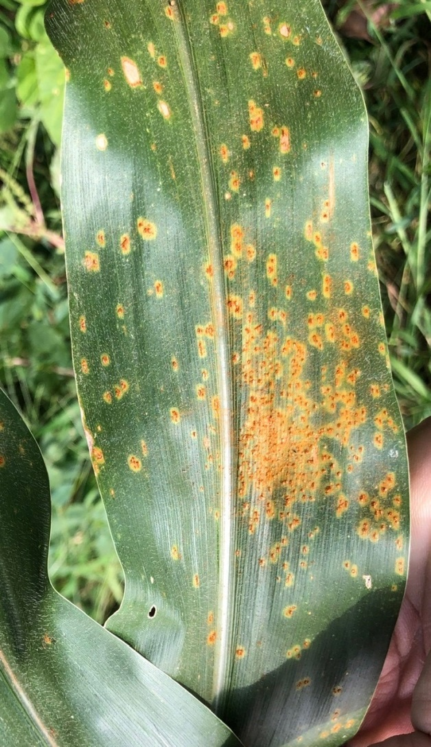
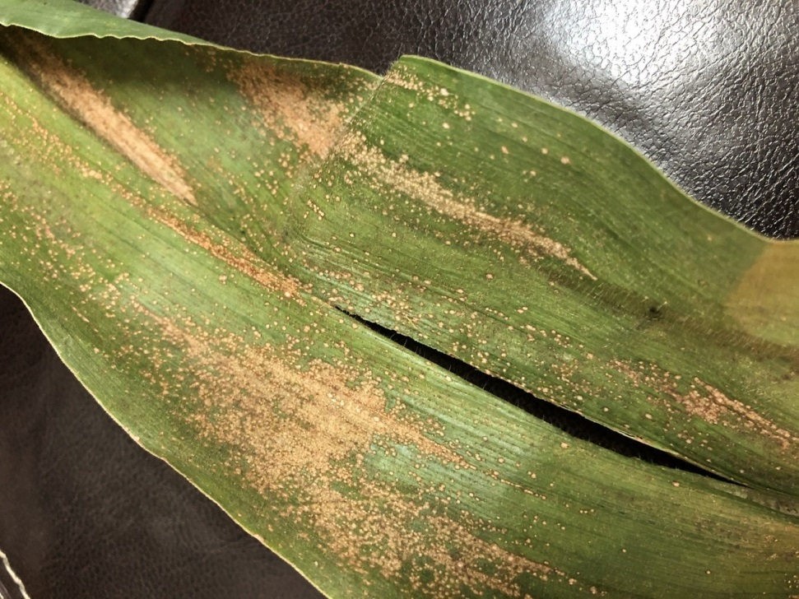
Southern Corn Rust vs Eyespot
The pathogen is a fungus called Aureobasidium zeae (Kabatiella zeae). It overwinters in the residue from corn, which is its only reported host.

Slide 25
I was wrong…..
Abiotic.

Slide 26
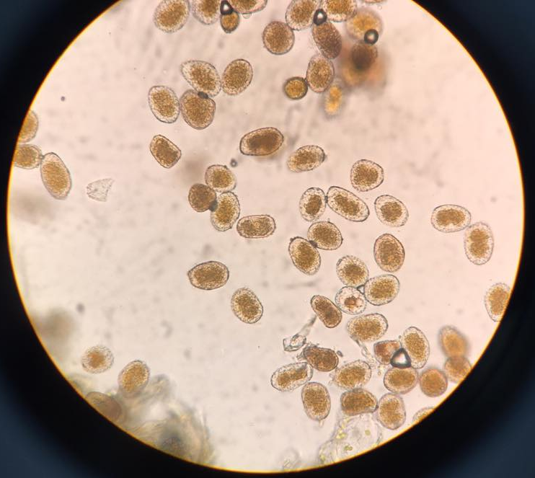

Slide 27
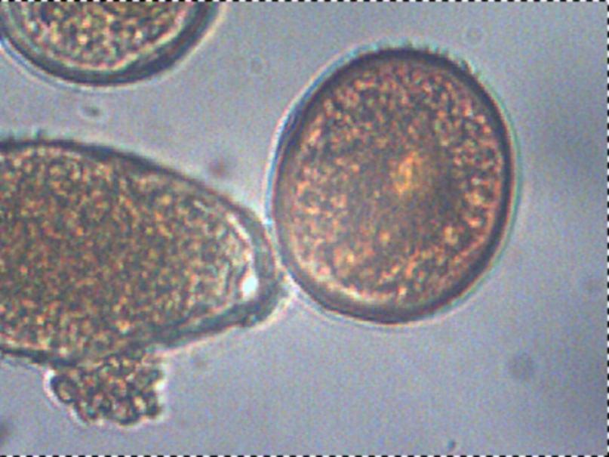
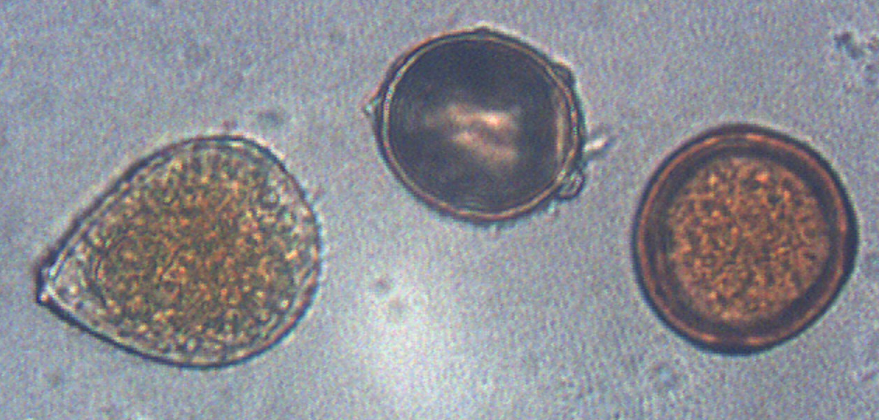
Southern Rust
Common Rust

Slide 28
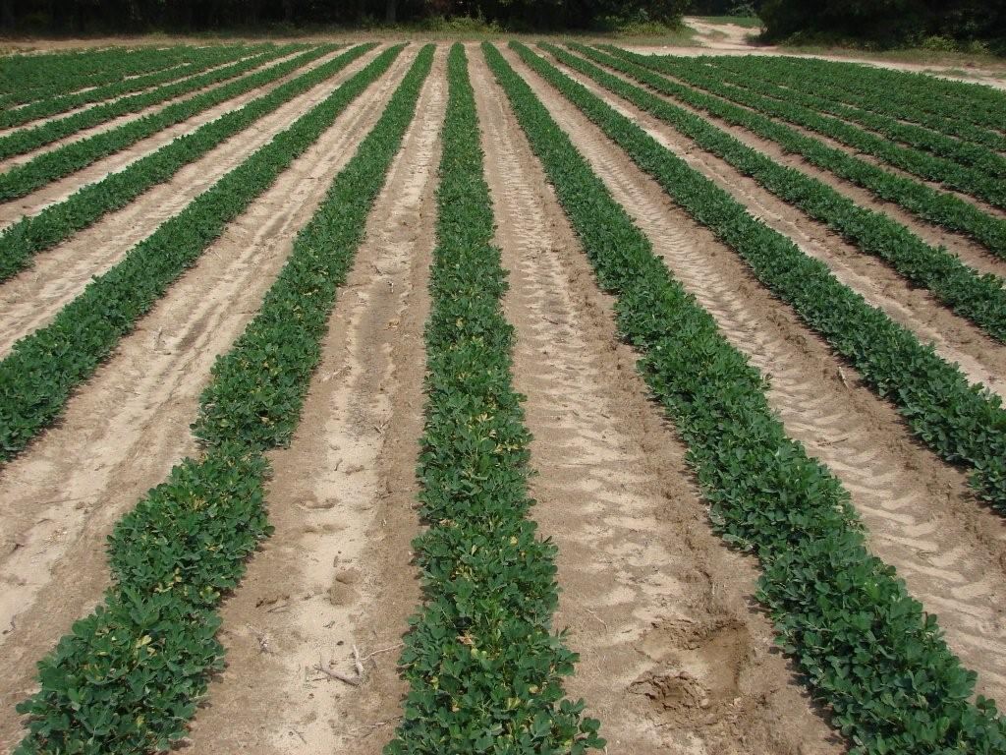
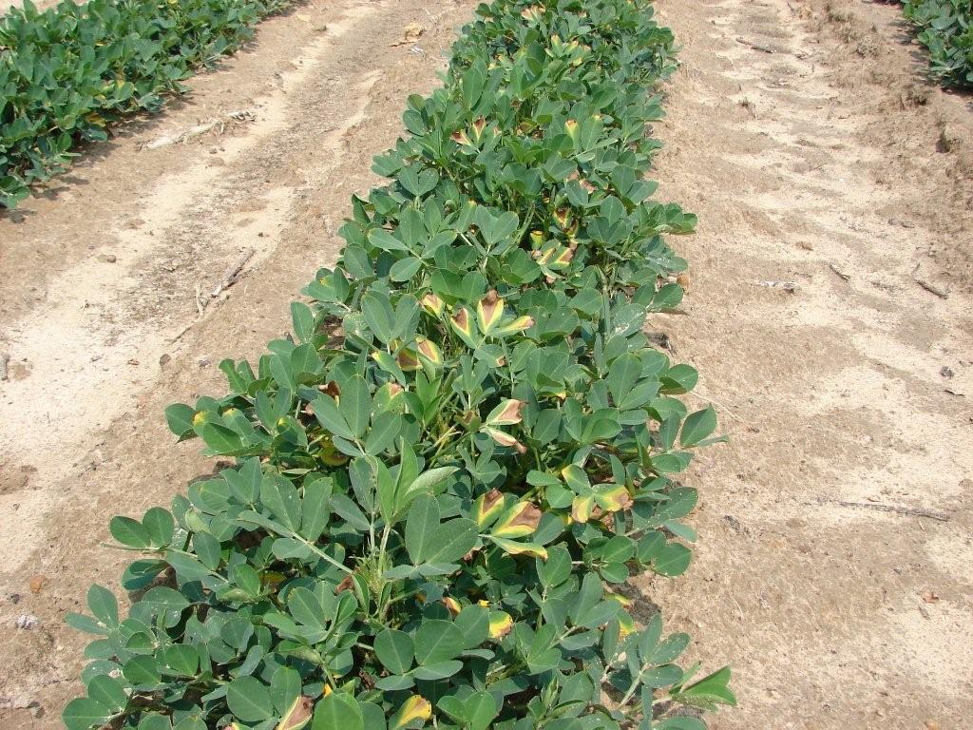
Burke County 2011 looks like peanut leaf scorch Leptosphaerulina crassiasca, but….

Slide 29
Why correct ID is essential for control recommendations
Incorrect ID costs a grower time.
Incorrect ID costs a grower money.
Incorrect ID costs a grower yield and profit.
Incorrect ID affects trust a grower has for Extension.

Slide 30
Clues to ID in the field: patterns of infections, how to use a hand lens, common disease names
Robert C. Kemerait Jr., PhD
Professor and Extension Specialist
Department of Plant Pathology
University of Georgia CAES
Follow on Twitter “bob kemerait”

Slide 31
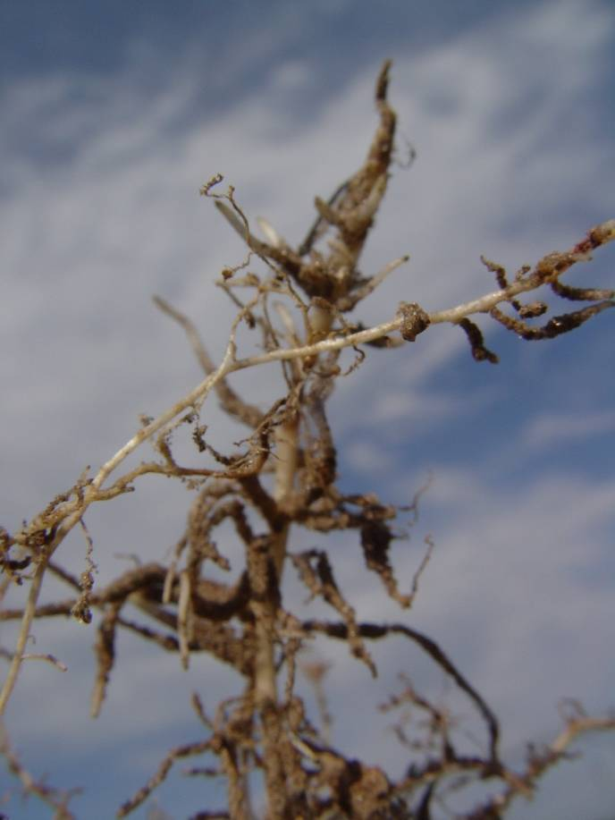
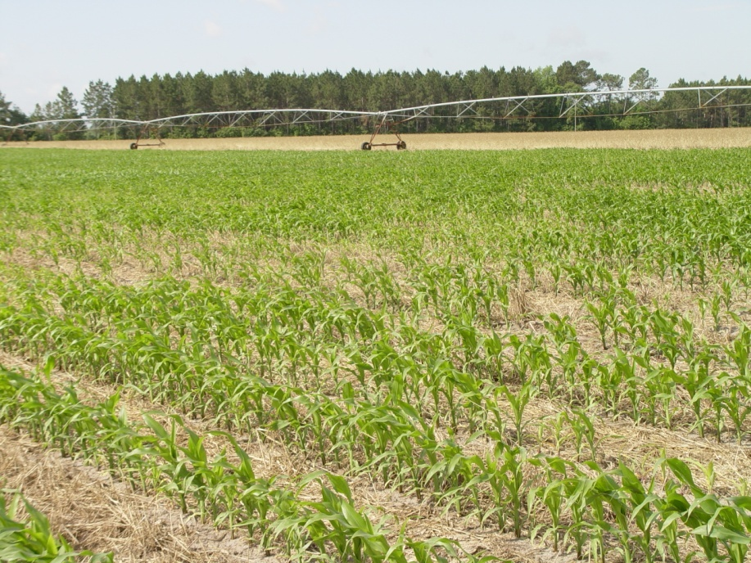
Damage from root-knot and stubby-root nematodes in Georgia

Slide 32


Leaf Scorch???

Slide 33


Slide 34
Why this Presentation?
Plant disease diagnosis/trouble-shooting calls/field visits/field diagnosis are a critical service provided by Extension agents.
The ability to provide such service differentiates one Cooperative Extension service from many others.
Extension Services often have many early-career agents who operate with much less “mentoring” than the past.
Current crop values and costs associated with disease and nematode management put pressure on the grower and the agent. TIMELY DIAGNOSIS CAN IS CRITICAL FOR GROWERS.
Most of early-career agents have limited (at best) experience in field diagnosis and field visits can be intimidating and frustrating.

Slide 35
Resources and Tools
Plant Disease Compendia American Phytopathological Society (APS).
Hand lens
Camera (with macro lens)
Compound microscope
Dissecting microscope
Pocket knife
Ice-cooler
Shovel/spade
Hand shears
Zip-loc bags and Sharpie
Microscope slides, etc.
CLEAR SCOTCH TAPE

Slide 36
Today’s Objectives
To provide agents with the very practical fundamentals of disease diagnosis for field crops.
To provide basic tools and resources for successful outcome s when you are given a disease sample.
To provide agents with a specific agenda/”list of tasks” upon which to focus for successful diagnosis.
To instill in agents the confidence to provide at least attempt to use your microscopic equipment.

Slide 37
EXTREME CAUTION!!!
Things NEVER TO DO when talking to client:
  Give answers beyond your knowledge.
  Guess at an answer(unless EDUCATED guess is appropriate).
  Assign blame for a problem in a direction (for example neighbor, fungicide, herbicide, nutrient deficiency) without having the facts/proof to back it up.
  Dismiss importance of the problem to the grower (even if you recognize that the issue is minor).
Things TO DO in conversation:
  Listen closely to grower and ask as many questions as needed.
  Answer what you KNOW, assure grower you can follow up on what you do not know; collect needed information.
  Follow through with any promised information.
  Provide appropriate “educated guesses” and identify as such.

Slide 38
Differentiating Patterns:
Diseases and Nematodes versus Chemical Injury
Stunting:
  Can be caused by nematodes, viruses, etc. and this should be confirmed by specific symptoms, maybe soil samples.
  Crop injury from herbicides, etc.- again, should be specific symptoms, e.g. distinctive damage to roots.
Yellowing/Discolored plants:
  May be associate with diseases and nematodes in clustered patterns.
  May be associated with general nutrition problem (general or clustered).
  May be associated with chemical injury (general across field)
Poor Stand- seedling disease? Poor seed? Look for signs.

Slide 39
Reasonable Expectations…….
Samples collected by the grower or by the agent are handled appropriately to best preserve both the plant materials AND the signs/symptoms.
Appropriate diagnostics are conducted quickly in county office and/or the sample is sent to the plant disease diagnostic lab (Athens or Tifton).
Results are accurate as possible- “best educated guesses” and “I don’t know” are reported only after diagnostic tools are exhausted.
Diagnostic results are coupled with effective management recommendations.

Slide 40
Things a grower may expect of you….
What is it?
How did it get here? My neighbor?
How bad is it? What kind of yield am I going to make now?
What can I do about it?
How come my fungicide/nematicide didn’t work?
I have NEVER seen this on my farm before…..

Slide 41
Steps for Successful Diagnosis
Collect representative samples from field.
Diseased tissue should not be completely dead as saprophytic fungi and bacteria cover up sample!!
Choose areas of sample at LEADING edges of the disease!
Form and idea of WHAT the disease is LIKELY to be if at all possible! Familiarize yourself with what you MIGHT find.
Assess sample FIRST visually with hand lens or dissecting microscope to locate areas to sample further.
Use scotch tape or other tools to form microscope slide to look at more carefully; separate the “wheat from the chaff”.

Slide 42
Collecting and Handling Plant and Nematode Soil Samples
Rule No. 1: best samples for diagnosis have early stages of disease, NOT completely ravaged!
Rule No. 2: When symptomatic plants are “clustered” in field, best to get samples from symptomatic plants near edge of area.
Rule No. 3: Remember that some foliar symptoms are actually the result of damage to roots and lower stem; carefully dig roots from soil; don’t pull them up!
Rule No. 4: Put plant tissue in Zip-loc bag with DRY paper towel and cool immediately; place in refrigerator if available; ship to diagnostic lab quickly.
Rule No. 5: Collect nematode samples from within root-zone of symptomatic plants, put in plastic bags and keep cool.

Slide 43
Realistic expectations for field diagnosis
For all field visits:
Good description and/or photographs of symptoms.
  Above-ground and below-ground
  Close-up and general plant symptoms
Careful notes describing the situation (see next slide).
Notes related to the pattern in the field.
Plant samples, effectively collected, labeled, stored, and shipped.
Soil samples, properly collected, labeled, stored, and shipped.
With experience (and proper knowledge):
Tentative (positive) diagnosis.
Recommendation for treatment.

Slide 44
Important Questions to Ask the Grower
When did you first start seeing symptoms?
What variety did you plant?
What is the cropping history for the field?
What pest problems have you seen in the field in other seasons?
What has been sprayed in the field?
  When were sprays made and what were field conditions?
Did you take nematode samples?

Slide 45
Realistic (as you learn) expectations for disease diagnosis
You should be able to:
Properly collect or acquire a sample.
Be able to come up with some possible ideas of what you are dealing with.
Have an idea of what to look for in the sample.
Be able to use a hand lens, a dissecting scope, and compound scope effectively.
Be able to take microscopic images and use DDDI.
Be able to recognize basic fungal structures.
With experience (and proper knowledge):
Tentative (positive) diagnosis.
Recommendation for treatment.

Slide 46
Patterns Mean Everything
When I make a field visit, I immediately study the patterns of the symptoms in the field.
  RANDOM: no clear pattern- typical of viral diseases and perhaps foliar diseases.
  CLUSTERED/CLUMPED: symptoms are likely to be found in certain areas of the field more than others; good examples; e.g. root-knot nematodes, Stemphylium leaf spot on cotton.
  ROW PATTERN: are symptoms associated with how the field was managed or sprayed?
  GRADIENTS: severity of disease/intensity of disease continues to build from one part of field to another; e.g. Asian soybean rust.
  POSITION IN THE CANOPY: e.g. leaf spots vs. spray burn.

Slide 47


Screven County and Tomato Spotted Wilt

Slide 48

Field Problems with Spotted Wilt

Slide 49

Screven County

Slide 50

Soybeans… sum it up in a single picture…

Slide 51



Slide 52

Tifguard vs GA-06G, 2010

Slide 53


Bacterial Blight

Slide 54


Cotton in Georgia 2021

Slide 55


Patterns…..

Slide 56



Non-fumigated
Fumigated with Telone II
Seminole County trial 2007
Southern root-knot nematode
Poncho Treated seed
Counter, 7 lb/A
Telone II, 3 gal/A + Poncho Treated Seed
Telone II, 6 gal/A + Poncho Treated Seed
Non-fumigated
Fumigated with Telone II

Slide 57
Diseases you are likely to encounter in a peanut field
Tomato spotted wilt:
  stunting, interveinal chlorosis, wilting
  Random pattern
Aspergillus crown rot:
  Early-season hot and dry
  Seedlings wilting rapidly, shredded main stem and dark, sooty sporulation
  Random in pattern
Rhizoctonia seedling blight:
  Early-season cool and wet
  Seedlings wilting, chocolate lesions on young tap root
  Random pattern

Slide 58
Diseases you are likely to encounter in a peanut field
Diplodia collar rot:
  Early season: looks like crown rot without the “soot”
  Later season: rapidly dying plants, gray limbs with tiny embedded black fruiting structures, rough to touch
  Random pattern, may be associated with TSWV
Stem rot (white mold):
  Early-season hot and dry make it worse
  Mature plants wilt/flag- often find profuse white fungal growth in crown of plant; DAMAGE IN CROWN AND LIMBS
  Later white growth may be absent, but look for shredding and presence of BB-size sclerotia
  Soft, rotted pods, soil tends to adhere to the pods
  Random in pattern early, but quickly forms clustered areas of damage
Rhizoctonia limb rot :
  Ample irrigation and rainfall, warm and wet
  Wilting along limbs, “target lesions” on limbs; blackened pegs

Slide 59
Diseases you are likely to encounter in a peanut field
Clindrocladium black rot
Peanut Root-knot nematodes
Early leaf spot
Late leaf spot
Funky leaf spot
Peanut Rust

Slide 60
Diseases you are likely to encounter in a soybean field
Rhizoctonia seedling disease
Frogeye leaf spot
Cercospora leaf blight
Downy mildew
Phomopsis pod and stem blight
Anthracnose

Slide 61
Diseases you are likely to encounter in a soybean field
Asian soybean rust
Stem rot (white mold)
Red crown rot (CBR…)
Charcoal rot
“Sudden Death Syndrome”??????
Nematodes: root-knot, reniform, cyst??, lance

